Slide 1

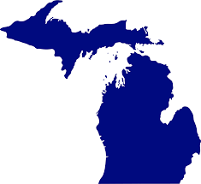




Welcome! - Introductions
Jeff Nieman
Jeffrey.nieman@spsmail.cuny.edu
Live in Detroit area
Work as program manager/data scientist
Proud alum of the UM college of engineering (Go Blue!)
Finishing up the data analytics program
Love music

Slide 2
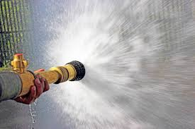
How you may feel at times

Slide 3
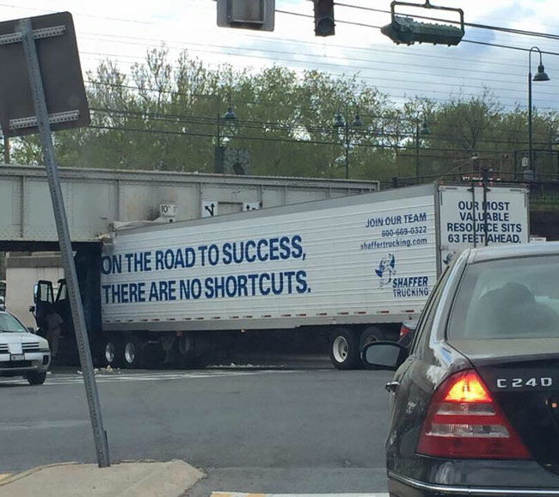
How you can solve it

Slide 4
Approach for this Bridge Class
3 weeks long – it is going to fly
Do the home works
Research – links, google, Safari books, your textbook all useful tools
Please participate – next two weeks you will get a chance to share your code – will help you learn from each other
You learn by doing – try
Take it in chunks

Slide 5
Things you need to do
Download R and Rstudio
Create an Rpubs account
Read the text
Try the ungraded quizzes
Complete the homework
  Loops
  Functions
  R Markdown
Submit both .rmd code and link to solution in RPubs

Slide 6
Overview of Material – what is R?
Language and environment for statistical computing & graphics
Free software
>10,000 available packages
Examples of Using R
Simple commands
Vector, Matrix, Array, Data Frame
Packages
Help

